Slide 1

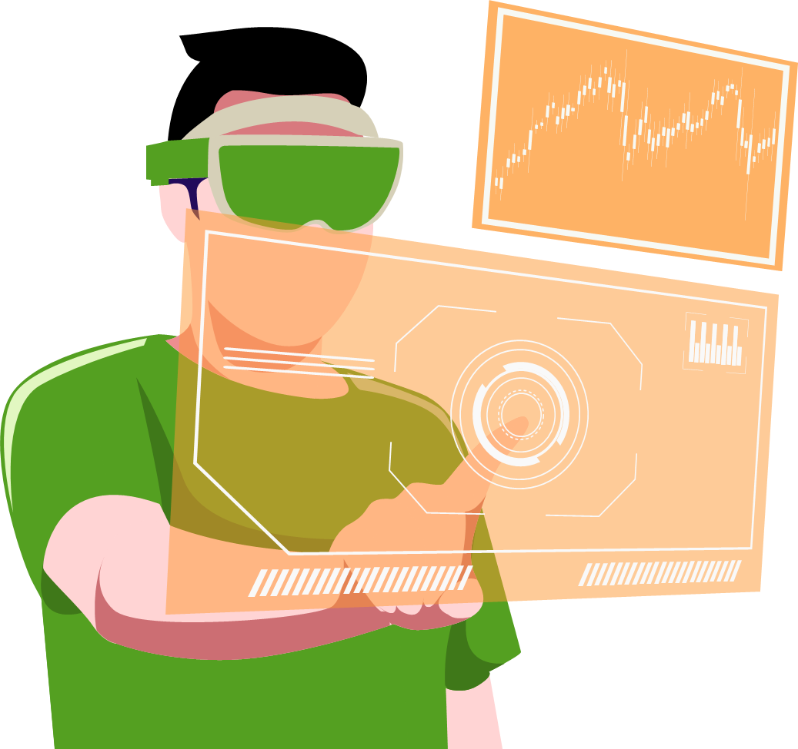
Photoplethysmography Prototype
using IoT-based Sensors for Continuous and Non-invasive Measurement of Vital Health Parameters
Electronics Engineering (B. Tech)
Archit Soni (20095014) Shubhi Singh (20095112)
Nishanth Gounder (20095074)
Devanshu Agrawal (20095035)
Supervisor:
Dr. Priya Ranjan Muduli

Slide 2
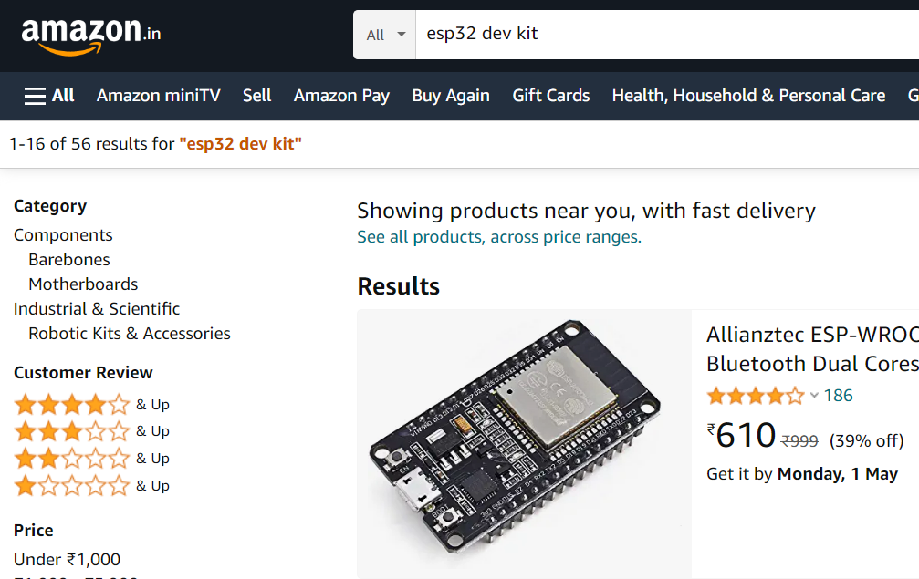
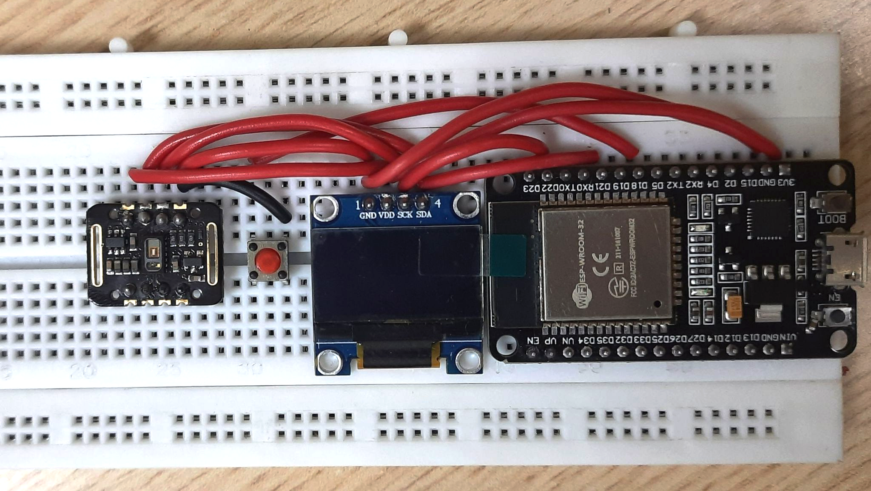
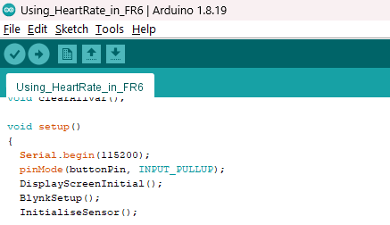
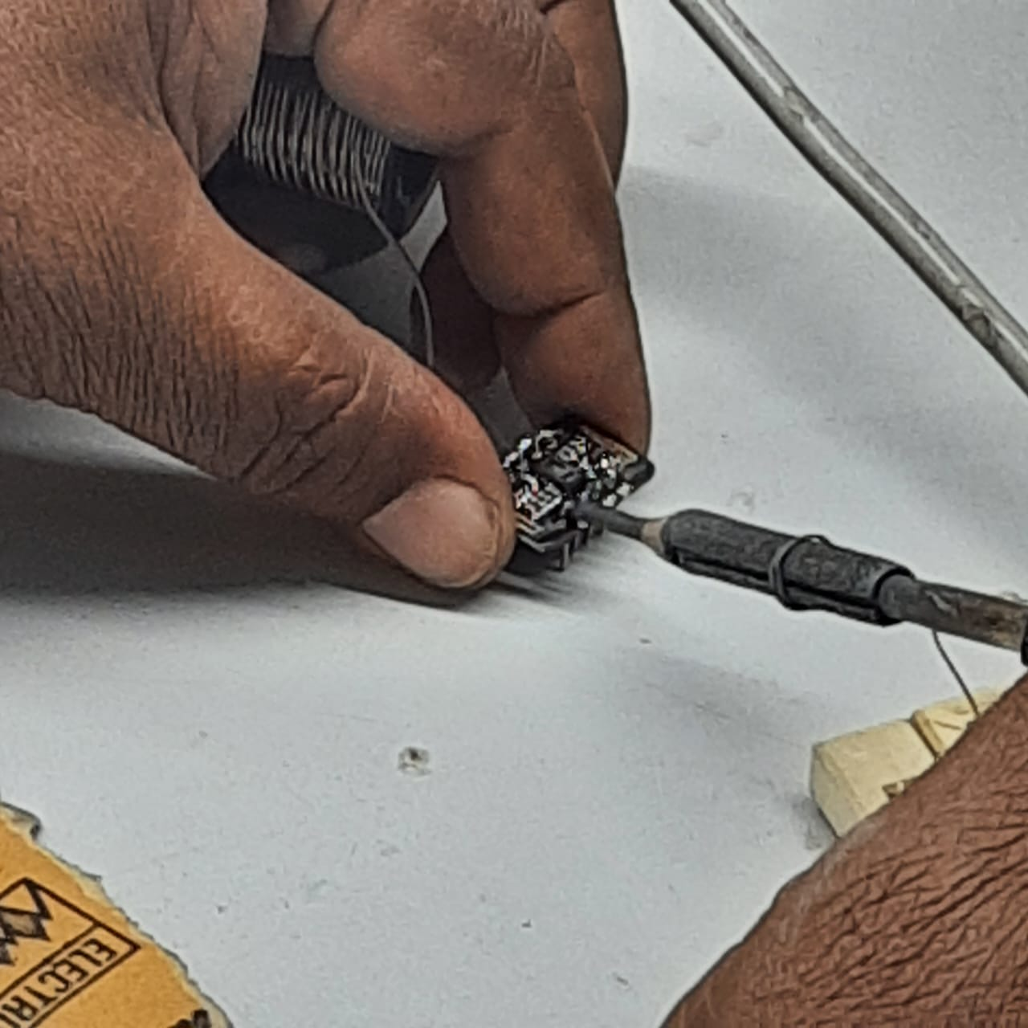
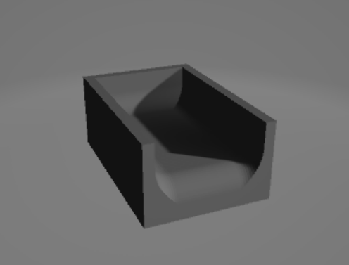
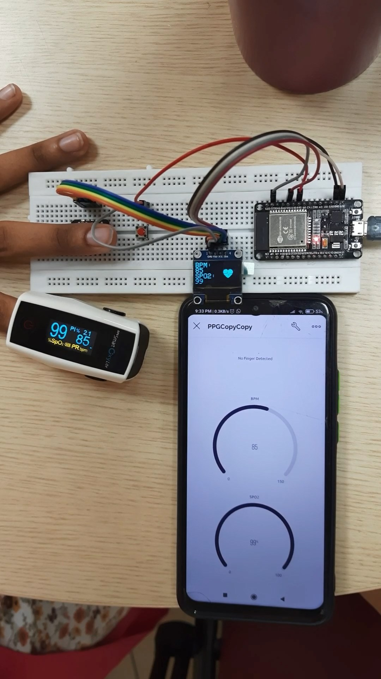
Previous Semester Timeline
Component Ordering
Circuit Assembly
Developing the Algorithm
Soldering
3D Printing
Calibrating the Device

Slide 3
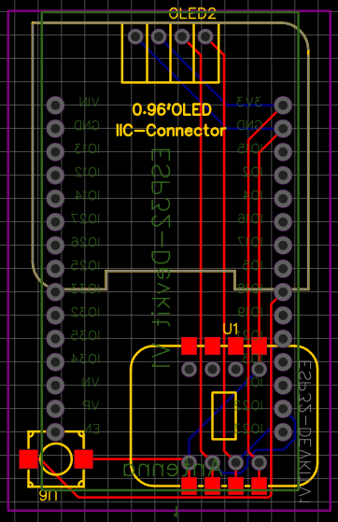
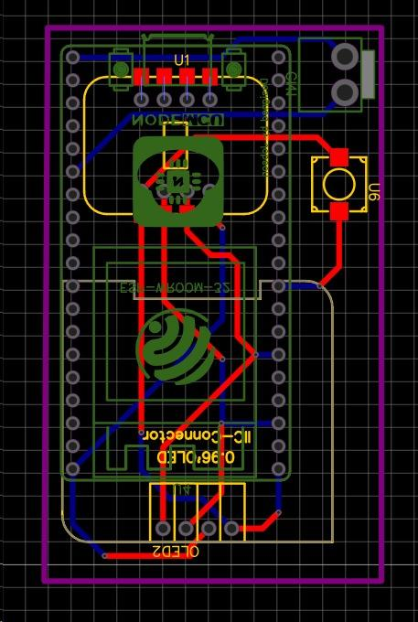
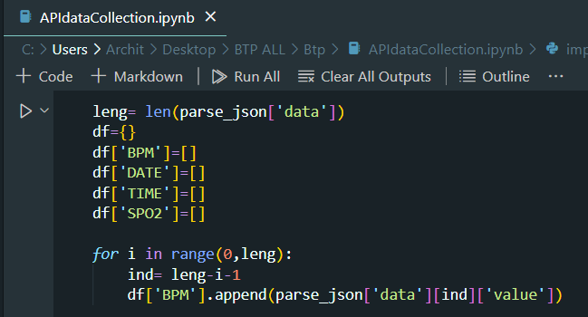
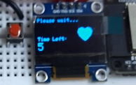
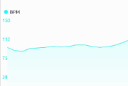
Current Semester Timeline
PCB Hardware
API Data Extraction
Algorithm Improvements
IoT Advancements
Startup Time Reduction
Calibrating the Device

Slide 4
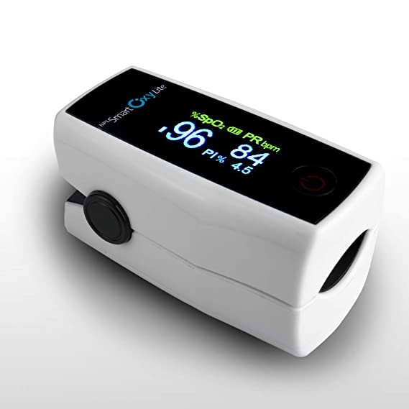
Existing Techniques
 | Pulse Oximeters | Smartwatches | ECG monitors | Our PPG device
IoT Device | ✗ | ✔ | ✗ | ✔
SpO₂ | ✔ | ✔ | ✔ | ✔
BPM | ✔ | ✔ | ✔ | ✔
Accuracy | ✔ | ✗ | ✔ | ✔
Ease of use | ✔ | ✔ | ✗ | ✔
Pulse Oximeter

Slide 5
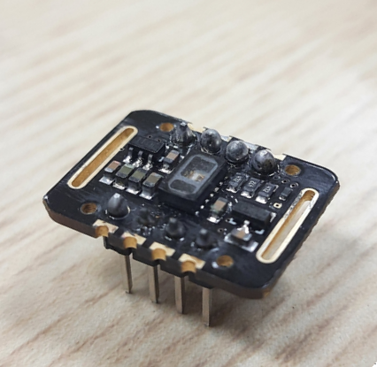
Components Used
01
MAX30102 Sensor
The MAX30102 sensor is a tiny but powerful module used for non-invasive monitoring of blood oxygen saturation and heart rate. It combines LEDs, a photodetector, and signal processing for accurate readings

Slide 6
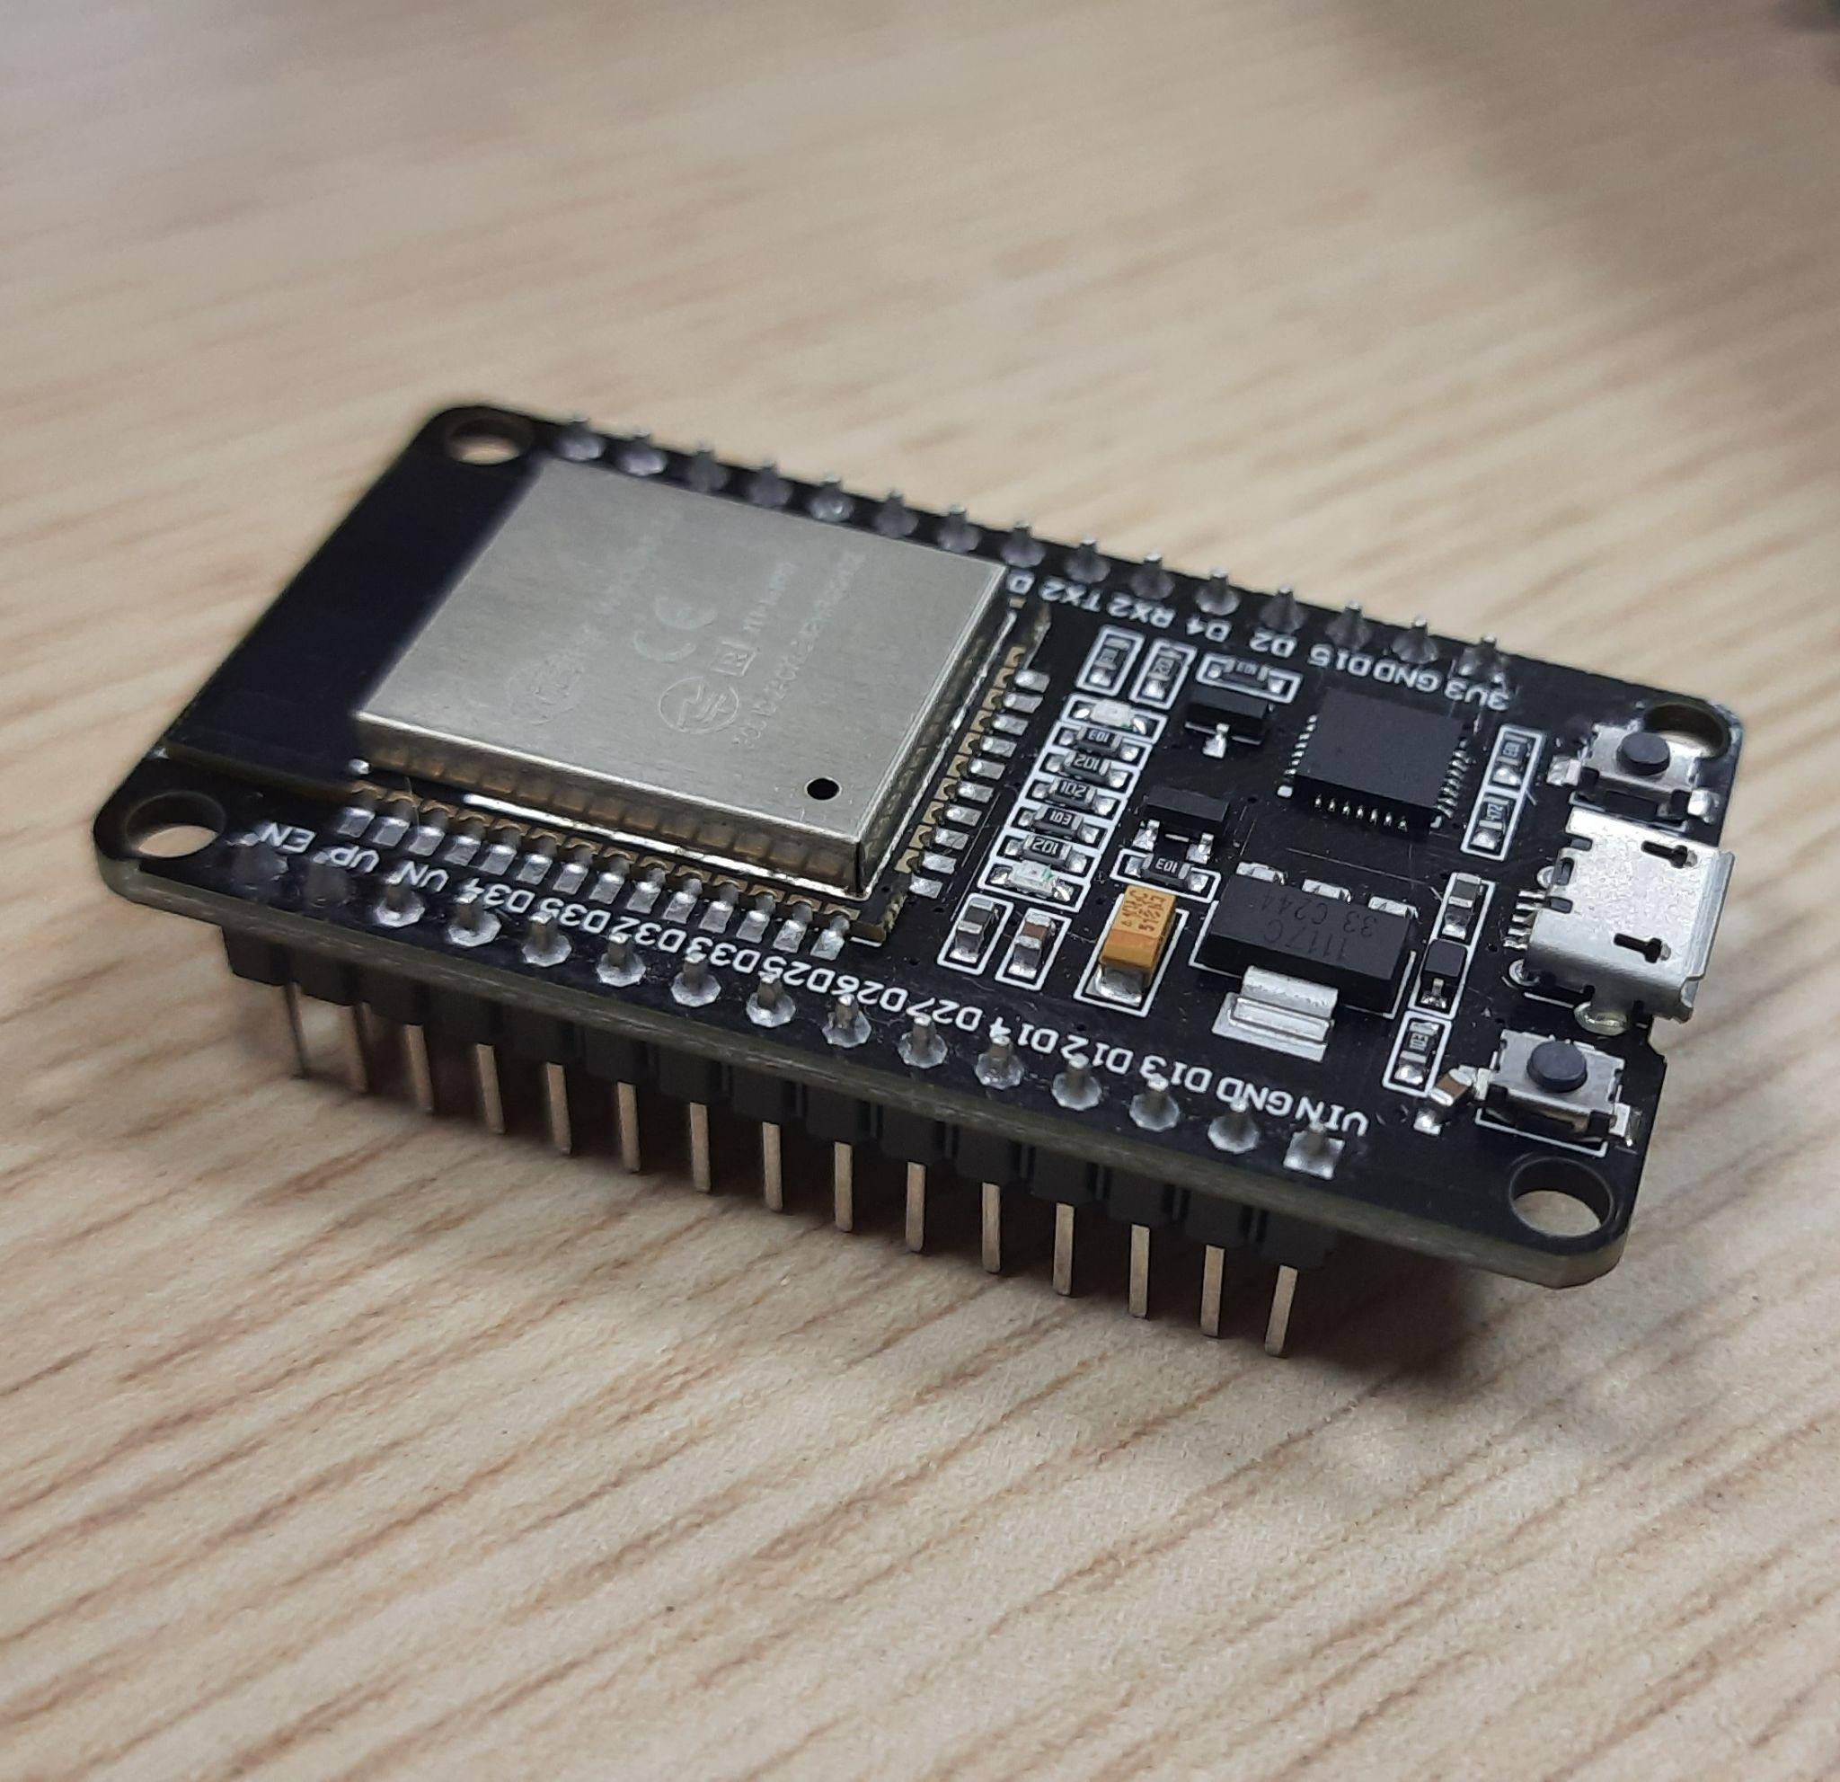
Components Used
02
ESP 32 Dev Board
The ESP32 Dev Board is a small, low-power, and versatile development board based on the ESP32 microcontroller. It has built-in WiFi and Bluetooth, making it ideal choice for IoT projects.

Slide 7
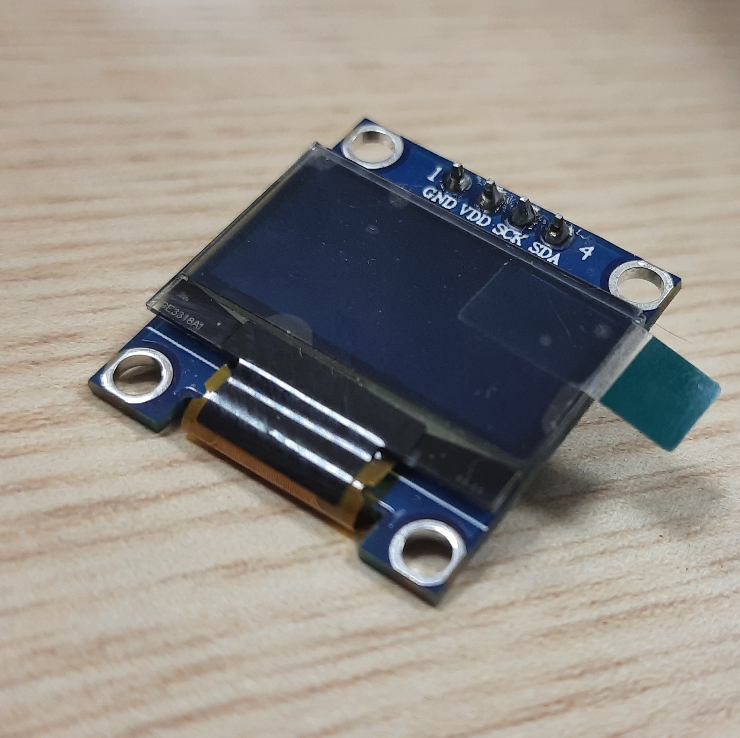
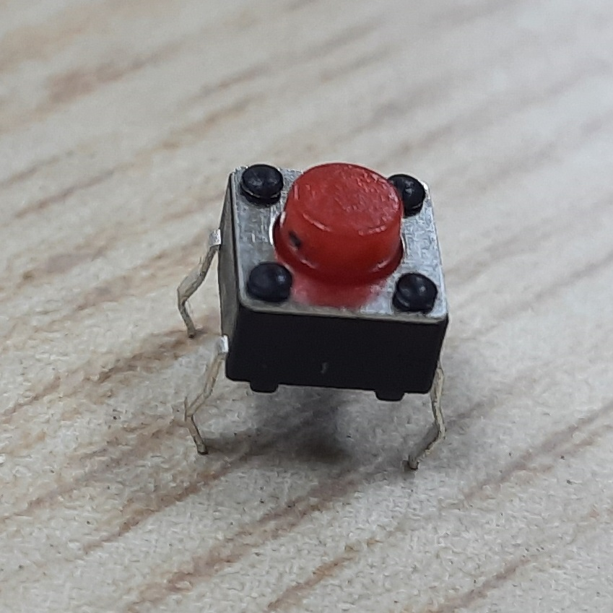
Components Used
03
04
OLED 128X64 Display
Push Button
The OLED display 128X64 is a small and high-contrast screen that uses organic light-emitting diodes to display graphics and text.
A simple switch used to start the device.

Slide 8
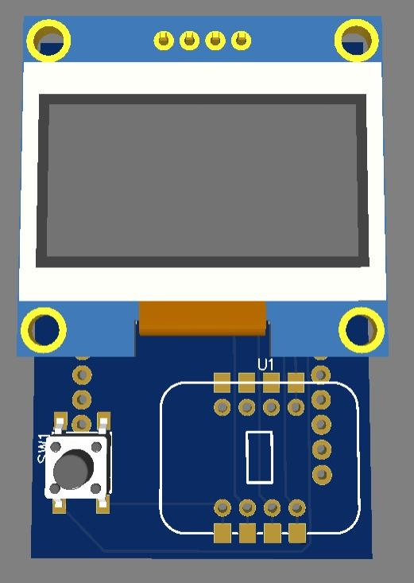
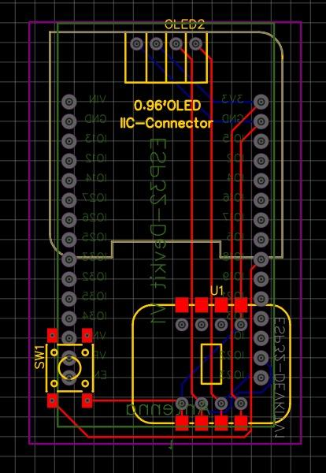
PCB Hardware
Used EasyEDA software for schematic and PCB design.
Developed a double-layer PCB for the prototype.

Slide 9
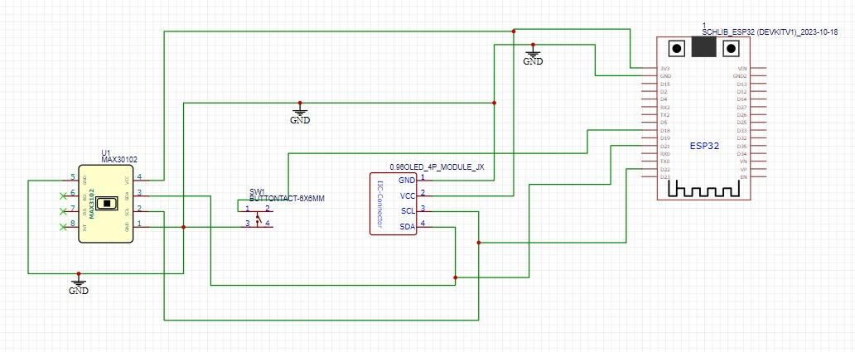
Circuit Schematic

Slide 10
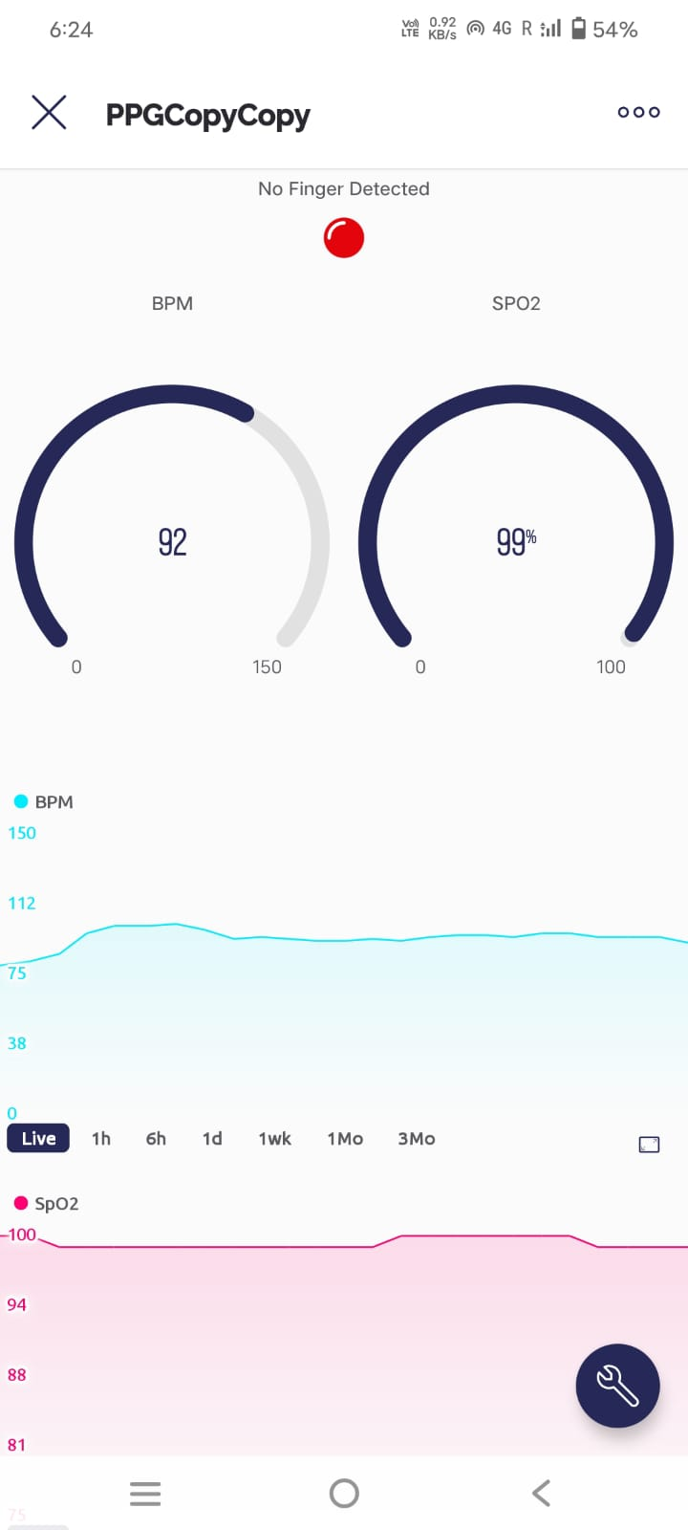
IoT Advancements: Graphing
New Graphing Feature in IoT: Integrated heart rate (BPM) and oxygen saturation (SpO2) visualization with adjustable scaling options for users.
Scales Available:
Live
1 hour
6 hours
1 day
1 week
1 month
3 months
This offers a comprehensive way to monitor and analyze health data dynamically.

Slide 11
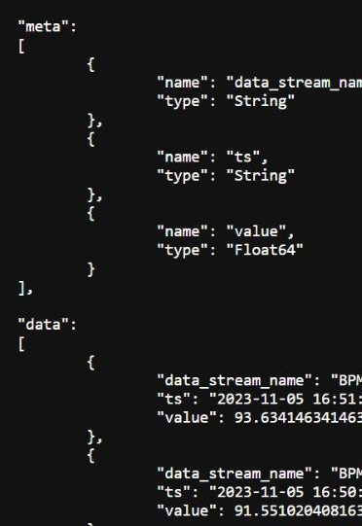
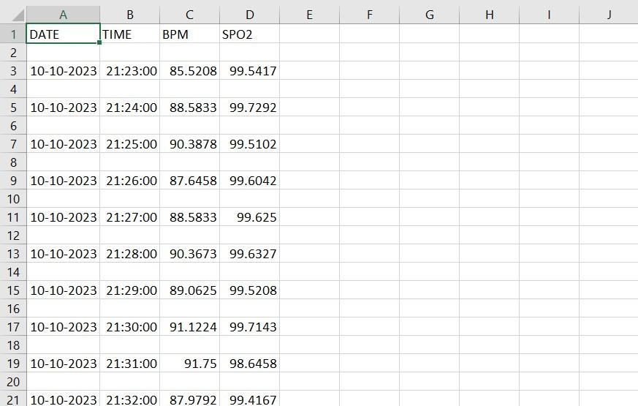
API Data Extraction
Enhanced IoT Data Retrieval:
Now, the IoT component supports API calls and data extraction through a Python script.
Users can conveniently convert the BPM and SpO2 data into CSV format, facilitating analysis and enhancing versatility in accessing health data.
API call JSON response
CSV generated by Python script

Slide 12
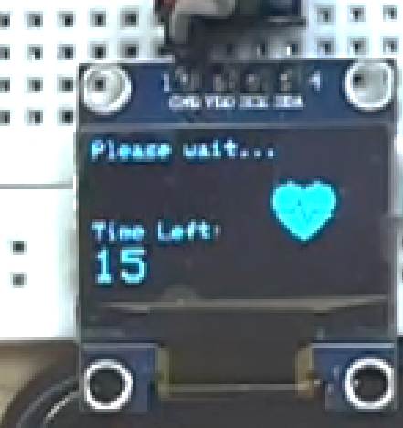
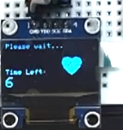
Startup Time Reduction
Achieved notable optimization in the device's performance, reducing the initial reading time from 15 seconds to 6 seconds.
This enhancement improves user efficiency, offering quicker access to essential data and making the device more responsive and user-friendly.

Slide 13
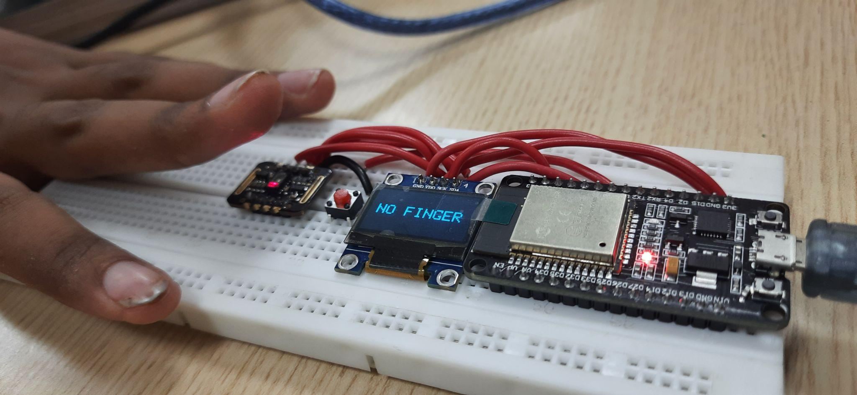
No Finger Mode
The prototype can detect if a finger isn’t placed on the sensor module.
Two Modes for Finger Detection:
Temporary Pause Mode: Briefly lifting the finger freezes readings; upon reapplication, readings resume.
Reset Mode: If the finger is removed for around 5 seconds or more, the device resets to the initial screen. We can adjust this time threshold.

Slide 14
Demonstration Video

Slide 15
Now let’s take a closer look at the display

Slide 16
No Finger Detection Demonstration

Slide 17
Thank You

